Slide 1
Lecture 25: State Design Pattern

Slide 2
State Pattern
If we have to change the behavior of an object based on its state, we can have a state variable in the Object.
Then we use if-else condition block to perform different actions based on the state.
State design pattern is used to provide a systematic and loosely coupled way to achieve this through Context and State implementations.

Slide 3
State Pattern Context is the class that has a State reference to one of the concrete implementations of the State.
Context forwards the request to the state object for processing.
Suppose we want to implement a TV Remote with a single ON/OFF button to perform the action. If the State is ON, it will turn off the TV and if state is OFF, it will turn on the TV.
Same button behaves differently depending on the current state.

Slide 4
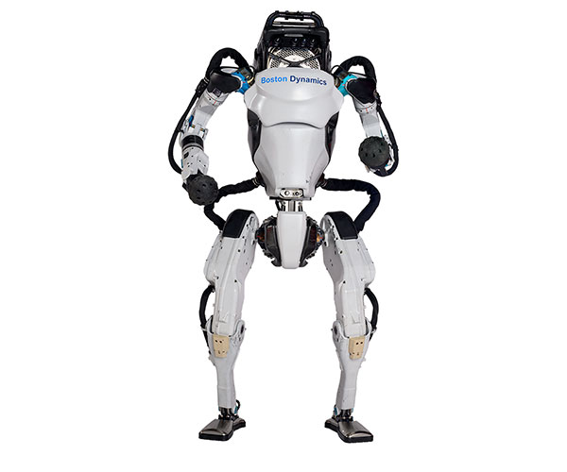
public void on();
public void walk();
public void bendKnees();
public void jump();
public void sit();
public void sideRoll();
public void frontRoll();
public void run();
public void off();
https://robots.ieee.org/robots/atlas2016/
https://www.youtube.com/watch?v=_sBBaNYex3E&feature=youtu.be
https://www.youtube.com/watch?v=_sBBaNYex3E&feature=youtu.be

Slide 5
Traditional Way
public class Robot {
final static int OFF=0;
final static int ON=1;
final static int WALKING=2;
final static int RUNNING=3;
int state = OFF;
public void on()
{
if state == OFF
state=ON
else if state == ON
. . .
else if state == WALKING
. . .
else if state == RUNNING
. . .
}
public void walk()
{
if state == OFF
System.out.println("Can't walk while switched off");
else if state == ON
state=WALKING
else if state == WALKING
System.out.println(“already Walking");
else if state == RUNNING
state=WALKING
}

Slide 6
State Pattern
public class Robot implements RoboticState{
private RoboticState roboticOn;
private RoboticState roboticWalking;
private RoboticState roboticRunning;
private RoboticState roboticOff;
//private RoboticState roboticStandby;
private RoboticState state;
public Robot(){
this.roboticOn = new RoboticOn(this);
this.roboticWalking = new RoboticWalking(this);
this.roboticRunning = new RoboticRunning(this);
this.roboticOff = new RoboticOff(this);
this.state = roboticOff;
}
public void setRoboticState(RoboticState state){
this.state = state;
}
@Override
public void on()
{
state.on();
}
@Override
public void walk()
{
state.walk();
}

Slide 7
Example of a Context Class
public class RoboticOn implements RoboticState{
private final Robot robot;
public RoboticOn(Robot robot){
this.robot = robot;
}
@Override
public void on()
{
System.out.println("Already on...");
}
@Override
public void walk()
{
robot.setState(robot.getRoboticWalking());
System.out.println("Now Walking...");
}
@Override
public void bendKnees()
{
}
@Override
public void jump()
{
}

Slide 8
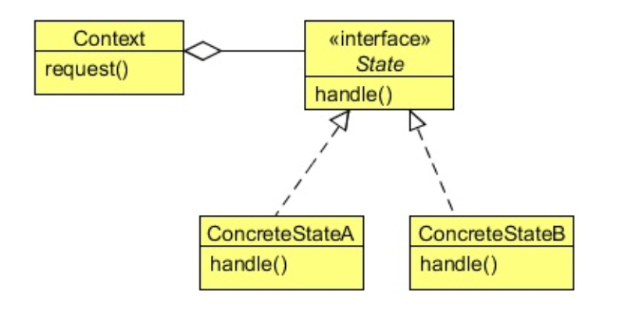

Slide 9
Demonstration & Class Assignment ( 0.3 bonus point will be given)
Watch the video and then add a new state named ‘RoboticStandby’. Define/modify all the relevant classes and methods. Also change the driver program to reflect your new state.

Slide 10
Next Lecture
Visitor Design Pattern

